Slide 1


METEOR - Brief Overview
Amit Sheth
Large Scale Distributed Information Systems Lab
at University of Georgia
http://lsdis.cs.uga.edu
Infocosm, Inc.
http://www.infocosm.com

Slide 2
Introduction
Research resulting in unique technology,
and ground-braking product to meet enterprises complex and dynamic process automation and process management needs

Slide 3
Research and Genesis
Research at the Large Scale Distributed Information Systems lab since March 1995, funded by NIST-ATP with the main goal of “improving US global competitiveness” and objective of “high-risk research leading to commercialization technology”, significant industry collaboration and funding, over $12000K used as of June 1998
Research in workflow pioneered since 1990 by Amit Sheth, with roots in industry

Slide 4
Technology and Product
METEOR product from Infocosm Inc. based on multi-paradigm workflow technology
Technology (alpha and beta versions) tested/evaluated with pilot/trial applications with LSDIS’s Industry and R&D partners (CHREF, SCRA, NIST, MCC, Boeing)

Slide 5
Business Process Reengineering
Use the power of modern information technology to radically redesign our business processes in order to achieve dramatic improvements in their performance.
[Hammer, Reengineering Work: Don’t Automate, Obliterate, Harvard Business Review, July-August 1990]

Slide 6
Workflow Process
A business process is a collection of activities related to a specific commitment, adding value to a product of an organization.
A workflow process is an automated business process.
A workflow management system is the software and tools to support workflow processes.

Slide 7
Workflow Management
as programming in the large,
and more.

Slide 8
Workflow Management System:
Conceptual Architecture (system components)
WF
Development
Toolkit
WF Enactment
Service
(run-time
system and
tools)
PM Toolkit
process
specification
- process view
- org. view
process
analysis
re-engineering
TQM advisor
...
graphical
workflow
design
testing
simulation
animation
scheduling
task manager/
interfaces
processing
entities
monitoring
tracking
reporting
...

Slide 9
Workflow Management System
A system that defines, creates and manages the execution of workflows through the use of software, running on one or more workflow engines, which is able to interpret the process definition, interact with workflow participants and, where required, invoke the use of IT tools and applications. [WfMC]
A set of tools providing support for process definition, workflow enactment, and administration and monitoring of workflow process.

Slide 10

The lure of workflow: it fits the trend
Workflow fits nicely with other trends,
such as
  re-engineering,
  downsizing / right-sizing,
  network computing,
  groupware, and
  client-server computing

Slide 11
Why Workflow Technology?
To streamline, coordinate and monitor an organizational process involving human and automated tasks spread across multiple enterprises with heterogeneous (existing and new) computing environments.
Some products focus on one aspect of workflow technology, primarily to reduce paper work or coordinate activities among humans:
  document management, imaging, e-mail routing, etc.

Slide 12
Benefits of Workflow Technology
Organize, schedule, control and monitor process
Help understand/improve process (analysis, simulate, reengineering)
Reduce paper work
Support on-line data entry where data originates; support data exchange and transactions across independent enterprises (EDI)
In most general form, workflow technology can be used to support programming-in-the-large

Slide 13
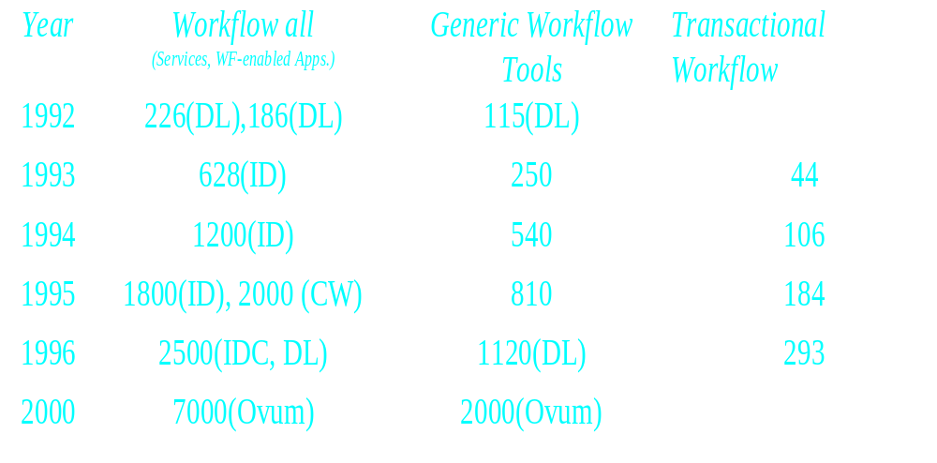
The lure of workflow: a large potential market
Market/Revenue Forecast for Workflow Software ($-mil)
Sources: ID = IDC & Advante; DL = Delphi Consulting; IT = International Data Corp., Communications Week, July 22, 1996.

Slide 14
Related markets
There is a very high growth in technologies and markets that METEOR users and makes much more useful: distributed computing infrastructure including CORBA, middleware including remote database access, Web, Java
There is a very growth rate in application/market segments that METEOR can help grow faster, including ERP, supply-chain, help desk

Slide 15
Market Approaches to Workflow
Internet
ORB
e-mail
workgroup/
collaborative
document mgmt.
imaging
database
TP-monitoring

Slide 16
State of the market-place
No single company with large market share; no clear market leader
Seven major players each with less than 15% market share
Very high growth market (50%), large absolute market size

Slide 17
Workflow Application Segments
Trade Press Classification
Repetitive
process
Unique
processes
High
Value
Business
processes
Production
Collaborative
Loan Origination
Insurance claims
Accounting
Tech doc creation
Product brand mgmt.
Software development
“ Transaction workflow”
“Process management”
Administrative
Ad Hoc
Expense reports
Purchase approvals
Budgeting
FYI Routing
Review and Approve
Low
value
processes
“ E - Forms”
“Groupware”
Source: BIS Strategic Decisions

Slide 18
Key conclusion from DocuLabs product comparison study
Products that allow development of complex applications, provide flexibility and support integration are very hard to use, take too long and require experience programmers (and are still not quite comprehensive)
Easy to use products are too restrictive --
and are useful for small or standard applications only
METEOR does not require you to make this compromise.

Slide 19
Observation
Current workflow products typically
  have client/server architecture
  are web-enabled (but not web-based)
The products can provide support for 80% of all possible workflow (work coordination) applications (of probably 30% of value) that
  are relatively simple, repetitive
  predominantly require human involvement (user/manual tasks), such as office automation

Slide 20
What is lacking?
Support for other 20% of the workflow applications (of possibly 70% of value) that are typically mission-critical and hence higher value, and require better support for
  existing/legacy applications, HAD environment
  error handling, automatic recovery
  scalability
  adaptive workflows, ,configurable and dynamic WfMS
  integral support for coordination and collaboration
  mobility

Slide 21
METEOR₂ Components
Workflow
Application
Designer
[MTDes]
Workflow
Component
Library
WIL [WPSL+]
W
e
b
W
o
r
k
WebWork Code
Generator
ORBWork Code
Generator
O
R
B
W
o
r
k
WF Run-time
Administrator
[Configurator/
Monitor]
WebWork
Workflow
Engine
ORBWork
Workflow
Engine
WorkObject Bus
processing entities (humans, databases,…)
services and distributed/network computing infrastructure

Slide 22
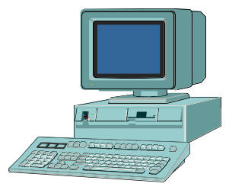

METEOR₂ Architecture
(Managing End-to-End OpeRations)
WORKFLOW
MODEL REPOSITORY
DESIGNER
MONITOR
AUTOMATIC CODE GENERATION
TASK
Mgr.
TASK
Mgr.
TASK
Mgr.
AND
TASK
TASK
TASK
DB
TASK
Mgr.
WEB /
CORBA
TASK

Slide 23
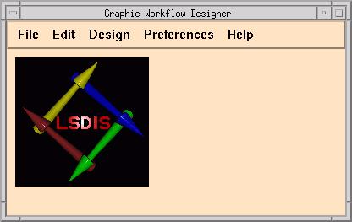
METEOR Workflow Designer
Comprehensive workflow design and development
Map Designer
Data Designer
Task Designer
Web Form Designer
Exception Designer

Slide 24
Requirements of a healthcare application developed with METEOR
Some of the important requirements for this application, as determined by our industry partner, include:
Support for a distributed architecture in a heterogeneous computing environment. At the level of any user of the system, this distribution should be transparent.
Support for inter- and intra-enterprise wide coordination of tasks.
Provision of a standard user-friendly interface to all users of the system.
Support for a variety of tasks: transactional and non-transactional, user and application.
Capability of using existing DBMS infrastructure across organizations.
Low cost of system for the providers and user organizations.
Ease of modification (re-design), scalability, extensibility and fast design-to-implementation.
Use of standards, including EDI for interactions between autonomous organizations where possible.
Security authorization for users and secure communication (required as patient data is typically confidential).

Slide 25
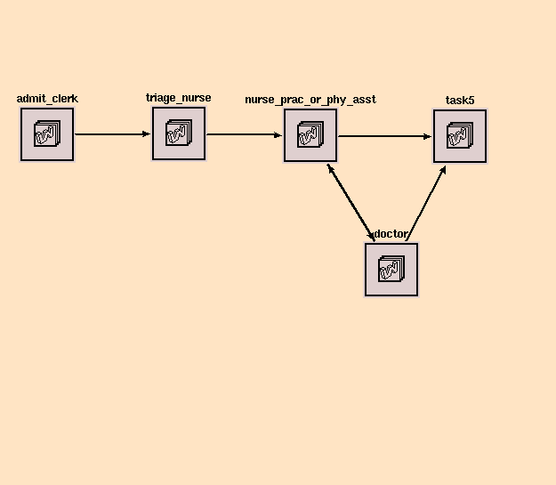
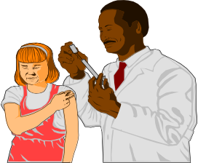

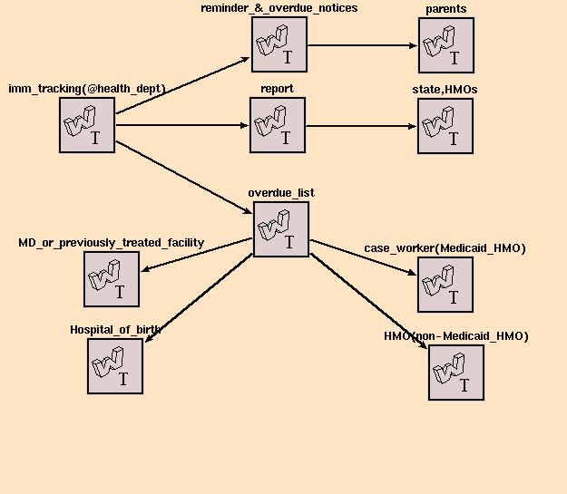


Schematic of Immunization Tracking
CLINICAL SUBSYSTEM
Generates:
Alerts to identify patient’s needs.
Contraindications to caution providers.
Reminders to parents
Health providers can obtain up-to-date
clinical and eligibility information
CT
Hospitals and clinics update central
databases after
encounters
Reports to state
Health agencies can
use reports generated
to track
population’s needs
SDOH and
CHREF maintain
databases,
support EDI transactions
Hospitals and
case workers
can reach
out to the population
State and HMO’s can update patient’s eligibility data
HMOs can keep track of performance
TRACKING SUBSYSTEM

Slide 26
Implementation Testbed:
Immunization Tracking Demo try out this testbed at http://lsdis.cs.uga.edu/workflow
Administrator
Case Worker
Admit
Clerk
Triage
Nurse
Doctor/
NP
Maternity Ward
(Solaris)
DBMS
CORBA
(Windows NT)
Hospital
Info System
MPI
MEI
Web Server
Web Server
Immunization
Database
(Solaris)
DBMS
(Solaris)
Encounter Database
CHREF
Hospital
EDI
CHREF/SDOH
Clinic
Office Practice
Mgmt System
(Solaris)
DBMS
Admit
Clerk
Triage
Nurse
Doctor/
NP
Insurance
Eligibility Database
Web Server
Encounter
Files/Databases

Slide 27
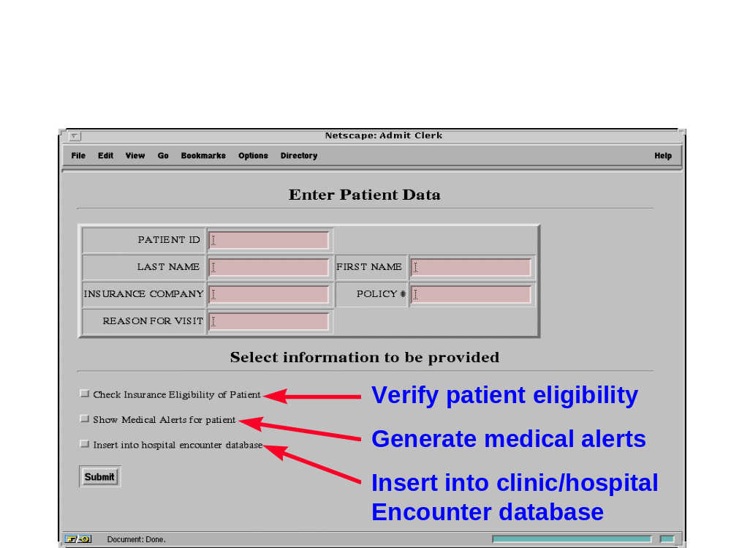
Web-based Implementation
Admit Clerk Task
Update Personal
Data
Triage Nurse Task
Update Local
Database
Start
Start
. . . .
Stop
Enter Patient
Info.
Generate
Alerts
Collect
Vitals
Workflow Design
Check
Eligibility
Implementation
Updated
Results
Update Personal
Data
Generate Triage
Nurse’s Page
N
Generate
Alerts
CGI
Display
Worklist
CGI
Enter Patient
Update Local
Database
CGI
CGI
CGI
CGI
PULL
N
Add to
Worklist
N
DBMS
N
N
HTTP
N
N
WORKLIST
HANDLER
Enter
Patient Info.
CGI
Enter
Patient Info.
Enter
Patient Info.
Alert Results
Eligibility
Results
Machine Boundary
Check
Eligibility
Worklist
File
N
Web Page
Submit Button

Slide 28
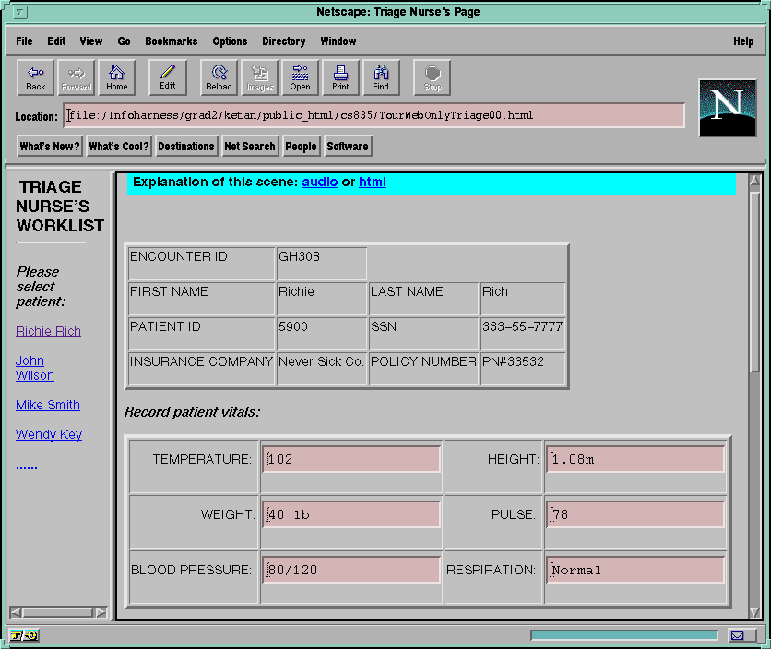
Web-based Implementation
Admit Clerk Task
Update Personal
Data
Triage Nurse Task
Update Local
Database
Start
Start
. . . .
Stop
Enter Patient
Info.
Generate
Alerts
Collect
Vitals
Workflow Design
Check
Eligibility
Implementation
Updated
Results
Update Personal
Data
Generate Triage
Nurse’s Page
N
Generate
Alerts
CGI
Display
Worklist
CGI
Enter Patient
Update Local
Database
CGI
CGI
CGI
CGI
PULL
N
N
N
Add to
Worklist
N
DBMS
HTTP
WORKLIST
HANDLER
WORKLIST
HANDLER
N
N
WORKLIST
HANDLER
Enter
Patient Info.
CGI
Alert Results
Eligibility
Results
Machine Boundary
Check
Eligibility
Worklist
File
Worklist
File
Worklist
File
N
Web Page
Submit Button

Slide 29
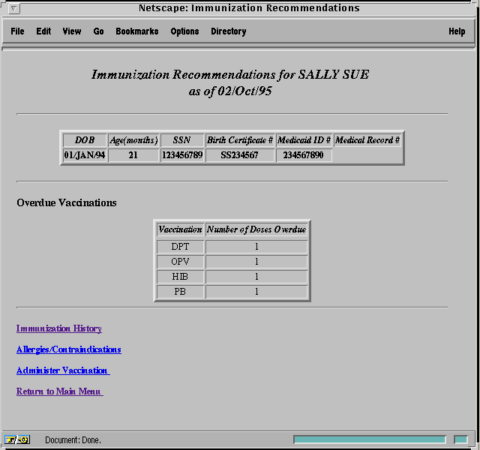
Provider Interface:
Immunization Reco’s
List of overdue vaccinations
Link to contraindication info obtained from the Internet
Clinical update to “administer vaccination”

Slide 30
CORBA-based Implementation
Admit Clerk Task
Update Personal
Data
Triage Nurse Task
Update Local
Database
Start
Start
. . . .
Stop
Enter Patient
Info.
Generate
Alerts
Collect
Vitals
Check
Eligibility
Workflow Design
Check
Eligibility
Implementation
Updated
Results
Update
Personal
Data
Patient Data (CORBA)
N
Generate
Alerts
CORBA
Update
Local
Database
CORBA
Enter Patient
Add to
Worklist
CORBA
CORBA
CORBA
HTTP
Worklist Handler
N
DBMS
N
N
Enter Patient Info.
CORBA
Machine Boundary
Alert Results
Check
Eligibility
Eligibility Results
Control Flow
N
Web Page
Submit Button

Slide 31
Distinction and technical advantages
Most importantly, no current vendor competes directly with us when a subset of the following are considered (and barrier to entry are significant)
  code generation
  fully distributed
  standards and latest distributed computing infrastructures for heterogeneous environments
  integration capabilities with legacy and new applications, and multiple/heterogeneous remote databases including mainframe data
  security

Slide 32
Why Infocosm-METEOR?
Generation shift (from first generation to second) and high-end market needs
  client-server to distributed (trend, scalability, flexibility, robustness requirement: E.g. BOEING)
  new generation of distributed computing infrastructure (WWW, CORBA and Java) and new standards: some companies are going for CORBA standard (E.g. various CORBAmed and defense companies)
  new standards: OMG Workflow Facility is being proposed with METEOR as the prime example

Slide 33
Why Infocosm-METEOR?
Workflow management system can become a prime integration platform if it is open and standards-based; most products do noting to deal with heterogeneity commonly found in most enterprises
  METEOR is the first and currently only implementation using distributed Web and CORBA infrastructures

Slide 34
Why Infocosm-METEOR?
Many products are seen as consultant-ware with complex toolkits
  METEOR offers advanced code generation capability which can provide 60% to 80% saving in generating distributed workflow application in heterogeneous environments
  METEOR has a significant edge in ease of use, deployment and management

Slide 35
Key Markets
Vertical Markets
Healthcare
Manufacturing
Telecommunications
Defense
Finance
Horizontal Markets
Enabler or engine for ERP, supply-chain, help desk applications.

Slide 36
State of the business
Sales completed
  comprehensive documents and training program
  consulting and integration support available
Resources
  presentations and technical contacts
  pointers from research material
  CD-ROM for evaluation (free for academic institutions); evaluations on going

Slide 37
Work in progress
Java based Designer
Increasing use of server side Java and Enterprise JavaBeans
Error handling and recovery
More security (both for commercial and defense needs)
Industry partnerships being developed

Slide 38

Summary
METEOR+Infocosm offers unique solutions to realize the promise of recent advances in distributed computing infrastructure, middleware and Web, by quickly integrating applications and information systems, to support complex and dynamic business process management

Slide 39
Additional information
http: //infocosm.com
http://lsdis.cs.uga.edu
(for publications and presentations)

